Slide 1


Introduction to
Robotic Process Automation
Employee Attendance Management
Your Register No: 220701045
Name: Bhuvaanesh R
Guide Name : Mrs. J. Jinu Sophia
Designation : Assistant Professor (SG)
Department : Computer Science and Engineering

Slide 2
Abstract
The Employee Attendance Management System is an automated solution designed using UiPath RPA to streamline the process of tracking employee attendance and calculating daily working hours. The system reads employee data, including check-in and check-out times, from an Excel file and validates it against company policies. It automatically detects late arrivals and generates detailed reports. The solution runs daily via UiPath Orchestrator, enhancing efficiency by providing accurate and timely attendance records for HR and payroll systems. This project reduces manual effort, improves accuracy, and supports data-driven insights into workforce productivity.

Slide 3
Need for the Proposed System
Challenges with Manual Processes
  Inefficient and prone to errors in tracking attendance.
  Inconsistent calculations of working hours.
  Time-intensive for HR and payroll teams.
Automation for Efficiency
  Streamlines attendance tracking with minimal human intervention.
  Ensures accurate and real-time data processing.
Improved Accuracy and Insights
  Delivers detailed, error-free reports for decision-making.
  Tracks trends like late arrivals or overtime to optimize productivity.
Scalability and Customization
  Adapts to growing workforce needs.
  Flexible to accommodate specific company policies.

Slide 4
Advantages of the Proposed System
Automation of Attendance Tracking
  Eliminates manual effort and reduces errors.
  Ensures real-time processing of attendance data.
Accurate Working Hours Calculation
  Calculates total hours and late entries with precision.
  Aligns with company policies for consistent results.
Enhanced Reporting
  Generates detailed, easy-to-read reports for HR and payroll.
  Provides insights into employee productivity and attendance patterns.
Integration with Existing Systems
  Seamlessly integrates with HR and payroll systems.
  Simplifies performance analysis and salary processing.
Scalability and Flexibility
  Accommodates a growing workforce and diverse work schedules.
  Easily customizable to suit specific organizational needs.
Time and Cost Efficiency
  Reduces administrative workload.
  Saves time and operational costs through streamlined processes.

Slide 5
Literature Survey
Paper 1: "Automated Employee Attendance Using RPA"
Advantages:
  Reduces manual effort in attendance tracking.
  Minimizes human errors in calculating working hours.
  Integrates with HR systems for seamless payroll processing.
Disadvantages:
  Limited customization for specific company policies.
  High initial setup cost for RPA tools.
Paper 2: "Integration of RPA for Workforce Management"
Advantages:
  Scalable solution for organizations of all sizes.
  Real-time data processing for improved decision-making.
  Enhances compliance with labor laws through accurate records.
Disadvantages:
  Dependency on robust IT infrastructure.
  Requires skilled personnel for maintaining RPA workflows.

Slide 6
Main Objective
The primary objective of the Employee Attendance Management System is to:
Automate Attendance Tracking
  Eliminate manual effort in recording employee attendance.
  Ensure accurate tracking of check-in and check-out times.
Calculate Daily Working Hours
  Precisely compute total working hours in decimal format.
  Identify late arrivals and overtime based on company policies.
Generate Detailed Reports
  Provide error-free daily attendance reports for HR and payroll systems.
  Enhance insights into workforce productivity and compliance.
Enhance Operational Efficiency
  Streamline attendance management processes.
  Save time and improve overall workforce management.

Slide 7
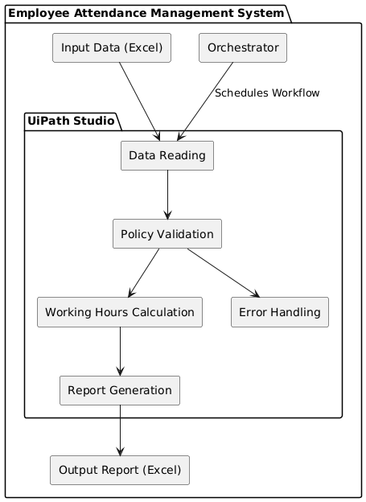
Architecture

Slide 8
System Requirements
1. Hardware Requirements
Processor: Intel Core i5 or higher
RAM: Minimum 8 GB (16 GB recommended for optimal performance)
Storage: At least 500 MB free space for tools and dependencies
Operating System: Windows 10 or later (64-bit)
Additional Hardware:
  Stable internet connection for cloud-based operations.
  A modern monitor with 1080p resolution for a clear workspace interface.
2. Software Requirements
UiPath Studio: Version 2023 or later for designing workflows.
UiPath Orchestrator: For scheduling and managing automated tasks.
Microsoft Excel: For input and output attendance data.

Slide 9
Functional Description
Module 1: Attendance Data Processing
Short Description:
This module is responsible for reading employee attendance data from an Excel file. It validates the input data (Employee ID, Check-in, and Check-out times) and checks it against predefined company policies, such as entry and exit times. Late entries and overtime are identified during this step.
Activity Diagram:
  Start → Load Attendance Data → Validate Data
  Check Late Entry → Mark Late (if applicable)
  Calculate Overtime → Save Processed Data → End
Module 2: Working Hours Calculation and Report Generation
Short Description:
This module calculates the total working hours in decimal format for each employee based on validated attendance data. It then generates a detailed daily report, which includes status (e.g., Present, Late, Overtime) and total working hours. The report is saved in a new Excel file for HR or payroll processing.
Activity Diagram:
  Start → Process Attendance Data → Calculate Working Hours
  Generate Report → Save to Excel → Notify HR Team → End

Slide 10
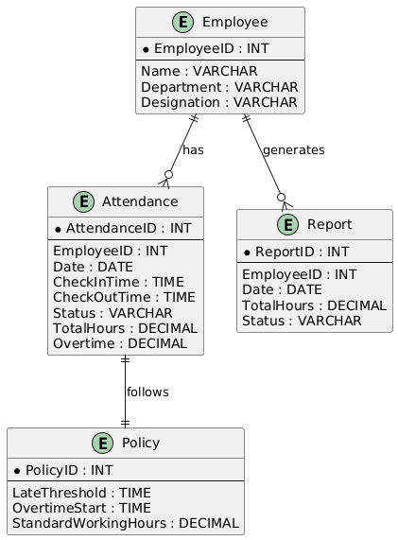
Table Design

Slide 11
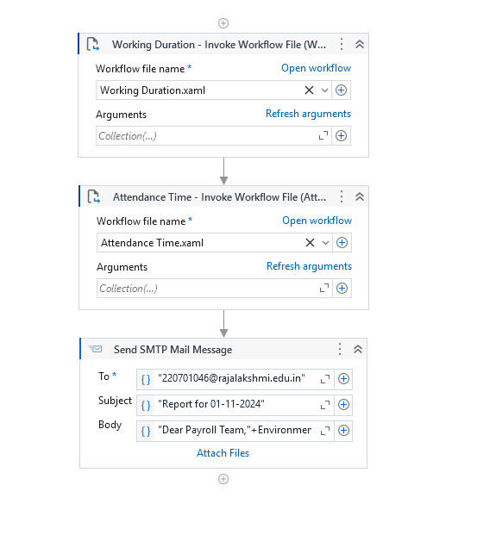
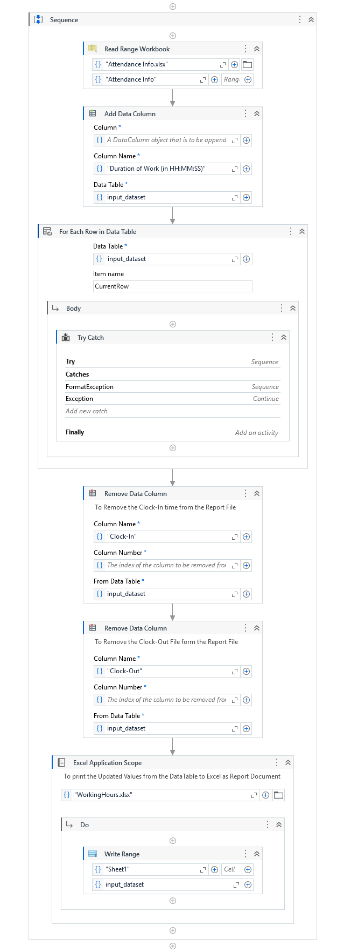
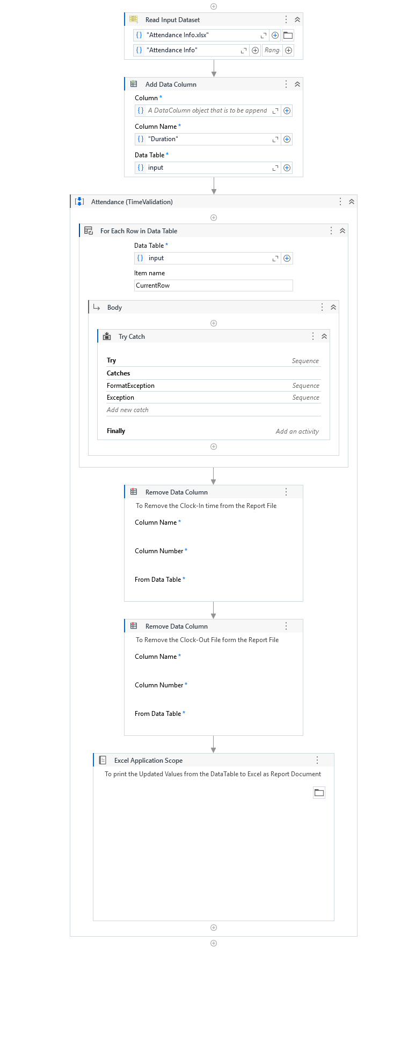
Process Design
Main Process Sub Process

Slide 12
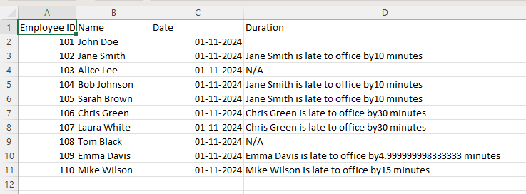
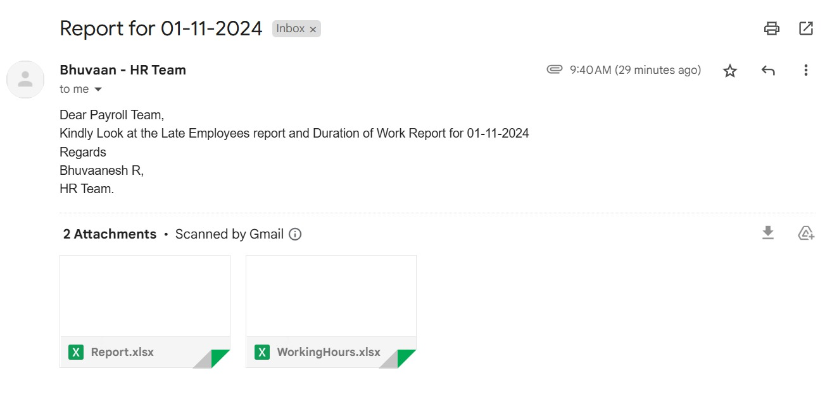
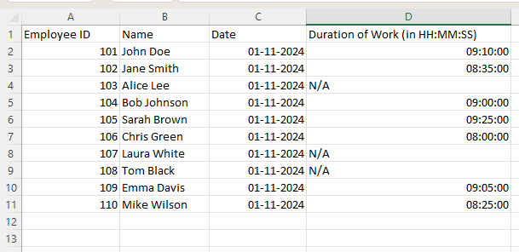
Testing

Slide 13
Conclusions
The Employee Attendance Management System successfully automates attendance tracking and working hour calculations, eliminating manual processes and improving operational efficiency. By leveraging UiPath RPA, the system ensures accuracy in attendance validation, late entry detection, and overtime calculation, while providing detailed reports for HR and payroll analysis.
This project highlights the potential of automation to enhance workforce productivity and streamline routine tasks. The integration with UiPath Orchestrator enables seamless daily execution, making it scalable and adaptable for future enhancements.
The system is a reliable and cost-effective solution, demonstrating the transformative impact of automation in optimizing business operations.

Slide 14
Future Enhancement
Cloud Integration:
  Host the system on cloud platforms for easier access, better scalability, and centralized data management.
Automated Notifications:
  Enable email or SMS alerts for late arrivals, overtime thresholds, or policy violations to keep employees informed.
Mobile App Integration:
  Develop a companion mobile app for employees to log attendance remotely, view their working hours, and access attendance records.

Slide 15
References
Smith, J., & Lee, R. (2020). "Automating Workforce Management: A Comprehensive Study on Attendance Systems." Journal of Workforce Optimization, 15(3), 45-60.
DOI: 10.1016/j.jwfo.2020.03.007
Kumar, S., & Patel, D. (2019). "Enhancing Employee Productivity through Automated Attendance Tracking." International Journal of Automation and Management, 10(2), 120-134.
DOI: 10.1007/s12345-019-0024-6
Nguyen, T., & Brown, H. (2021). "RPA and the Future of HR Operations: Applications in Attendance Management." Proceedings of the International Conference on Robotics and Automation (ICRA), 2021, 512-520.
Alvarez, P., & Johnson, K. (2018). "Design and Implementation of Time Tracking Systems: A Case Study." Computing in Business and Industry, 22(1), 89-98.
Chowdhury, A., & Singh, P. (2022). "Artificial Intelligence and Automation in Workforce Management." Journal of Emerging Technologies in Business, 8(4), 300-310.
DOI: 10.1045/jetb.2022.030

Slide 16
Queries

Slide 17
Demonstration

Slide 18
Thank You

